Slide 1
General announcements
Today:
Taking data for torque/energy lab (due )
1.)

Slide 2
Torque/energy lab
The procedure and lab handout are on the class Website.
You need to read the entire lab carefully before actually doing it to make sure you (a) understand what’s going on, and (b) have all the necessary data while in the classroom.
This is a formal writeup (lab cover, etc) and is due
Make sure you blurb, blurb, blurb!
Make sure you answer all the questions asked, and label them clearly so I can easily see the sequence of calculations. If I have to go hunting, you are more likely to lose points!
2.)

Slide 3
Torque/energy lab
We want to know if the rotational version of Newton’s Second Law actually works. To do that, we need:
ring stand
hub
smart pulley
1.) Determine the acceleration of the hanging mass as it accelerates downward.
m =.1 kg
2.) Determine the hub’s moment of inertia using conservation of energy. That will require a velocity versus time graph and a position versus time graph, both of which we need to generate.
3.)

Slide 4
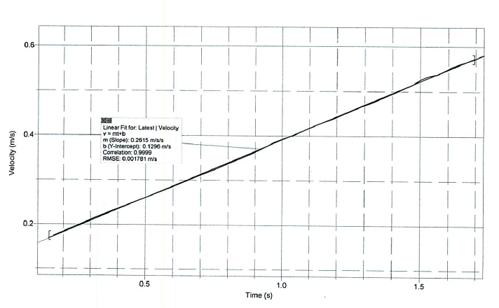
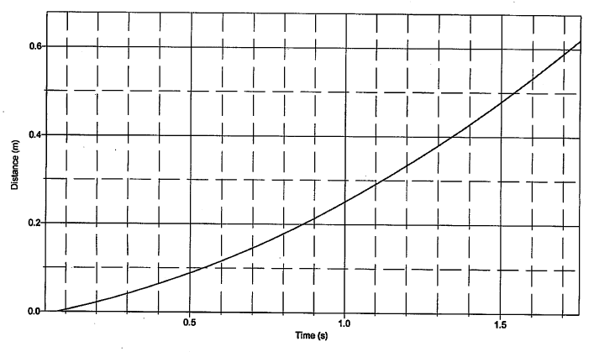
4.)

Slide 5
Rotational energy reminders
All our previous information about energy still holds:
Extraneous work changes the energy of a system
Rotational KE can be expressed by ½ I𝛚²
If the axis of rotation is also translating (e.g. ball rolling down hill) then its translational KE can be found by ½ mv² – both rotational and translational energy must be accounted for
Also remember that v = r 𝛚 when simplifying
Conservation of Energy can be used to compare two points in time
The U and extraneous work quantities in the CoE equation are unchanged: there is no such thing as “rotational potential energy” and extraneous work still behaves as before
We often assume an object is “rolling without slipping.” What does that mean?
Rolling without slipping means there is rolling friction at the point of contact that holds traction but take little energy out of the system. For our purposes, no slippage means no energy will be dissipated by friction (unlike sliding friction).
5.)

Slide 6
Approaching a rotational energy problem
Start with conservation of energy, and determine whether extraneous work is done or not
As before, determine what terms exist: U_{g}, U_{spring}, rKE, tKE at the initial and final times
After writing each term out in its base equation form (e.g. Mgh, ½ Mv², ½ I 𝛚² etc.) determine if any parts need to be substituted or determined in terms of thing you know (e.g. v = r 𝛚, or finding h in terms of known lengths/heights/angles)
Substitute, rearrange, and solve!
6.)

